Slide 1
Medical Billing
ENDOCRINE SYSTEM
AREEBA RAFIQ
5098

Slide 2
AGENDA

Slide 3
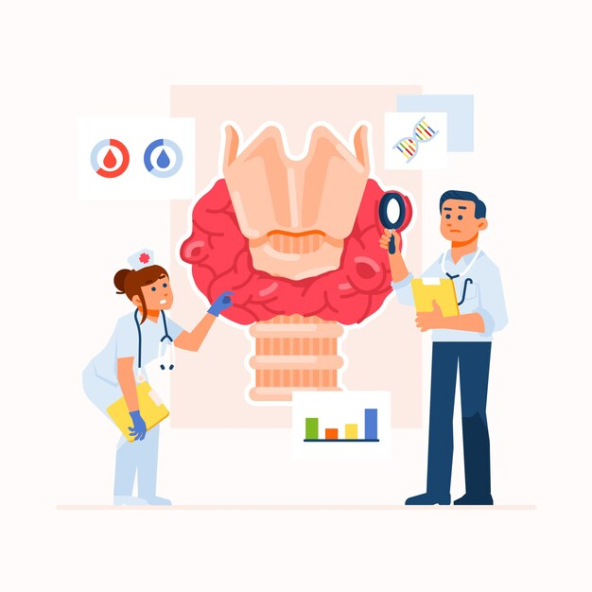
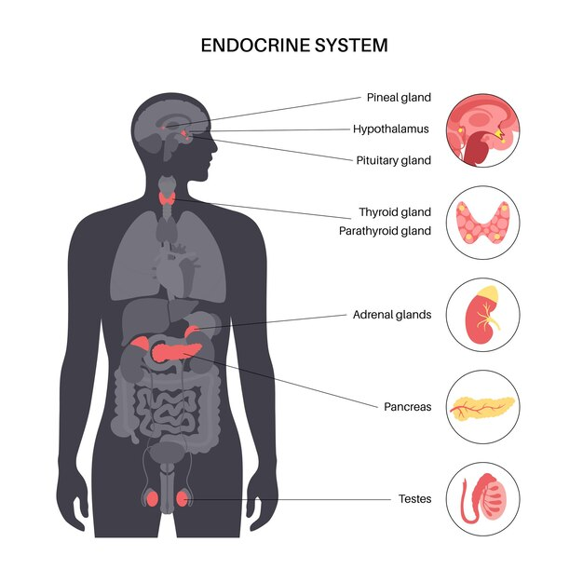
ENDOCRINE SYSTEM

Slide 4
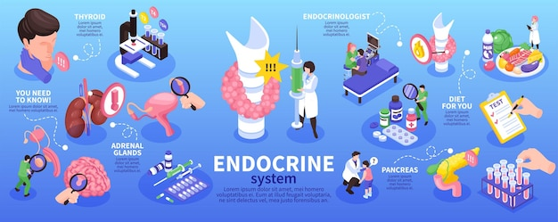
THE ENDOCRINE SYSTEM
The endocrine system is a complex network of glands and organs that produce, store, and secrete hormones, which are chemical messengers that regulate various physiological functions in the body. These hormones play a crucial role in maintaining homeostasis, coordinating growth and development, regulating metabolism, and responding to environmental stimuli.

Slide 5
COMPONENTS OF ENDOCRINE SYSTEM
HORMONES: They are chemical substances that are carried by a cell tissue and initiate specific action. Hormones can have very powerful effects, even when present in very low concentrations. The specific cells which are affected by a hormone are called target cells. Hormones travel through the bloodstream to target cells or organs, where they elicit specific responses. Examples of hormones include insulin, cortisol, thyroid hormones, estrogen, and testosterone.
Hormone Function
Regulate the chemical composition and volume of the internal environment (extracellular fluid).
Help regulate metabolism and energy balance.
Help regulate contraction of smooth and cardiac muscle fibers and secretion by glands.
Help maintain homeostasis, despite disruptions, such as infection, trauma, emotional stress, dehydration, starvation, hemorrhage, and temperature extremes.
Regulate certain activities of the immune system.
Play a role in the smooth, sequential integration of growth and development.
Contribute to the basic processes of reproduction, including gamete production, fertilization, nourishment of the embryo and fetus, delivery, and nourishment of the newborn.

Slide 6
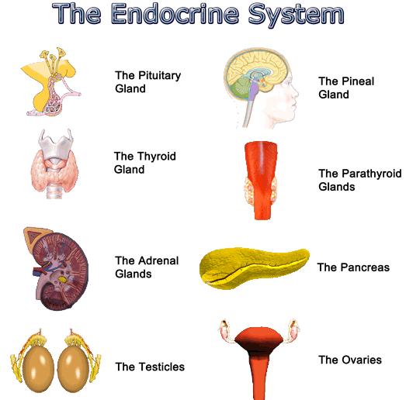
Glands:
These are specialized organs that release hormones
directly into the bloodstream. Major endocrine glands
include the
pituitary gland
thyroid gland
adrenal glands
Pancreas
parathyroid glands
gonads (testes in males and ovaries in females).
`

Slide 7
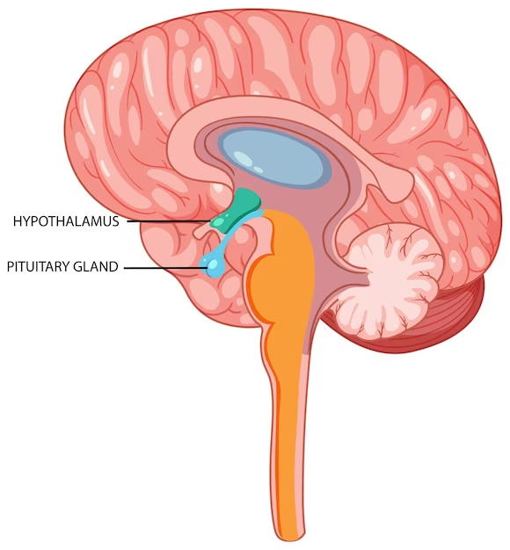
Pituitary Gland
The pituitary gland, often referred to as the "master gland," is a small, pea-sized gland located at the base of the brain It is a crucial component of the endocrine system and plays a central role in regulating various physiological processes in the body.
The pituitary gland consists of two main parts:
Anterior Pituitary (Adenohypophysis): This part produces and releases several hormones, including growth hormone, thyroid-stimulating hormone, adrenocorticotropic hormone, follicle-stimulating hormone, luteinizing hormone, and prolactin.
Posterior Pituitary (Neurohypophysis): This part stores and releases hormones produced by the hypothalamus, including oxytocin and vasopressin (antidiuretic hormone).

Slide 8
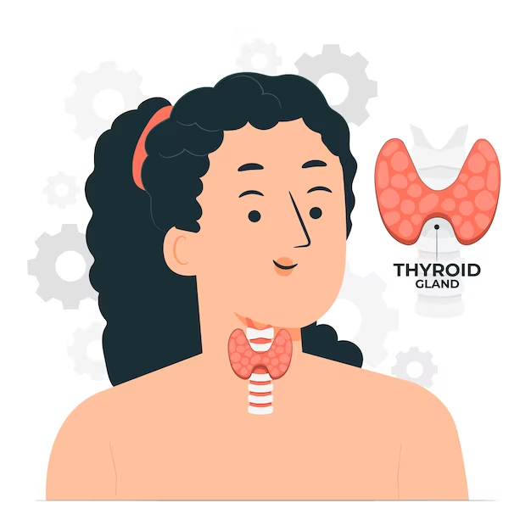
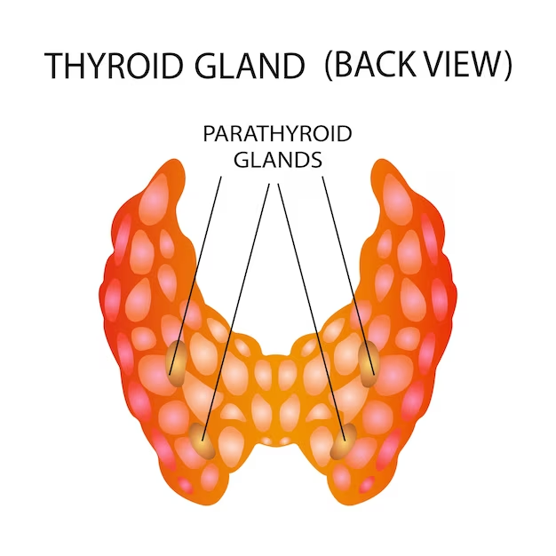
Thyroid Gland
The thyroid gland is a butterfly-shaped endocrine gland located in the neck and produces hormones called thyroxine(T4) and triiodothyronine(T3). These hormones release metabolism, energy production, and body sensitivity to other hormones.
Parathyroid Gland
There are four small parathyroid glands located at the back of the parathyroid glands. They produce parathyroid hormone(PTH) which regulate calcium levels in bone and blood.

Slide 9
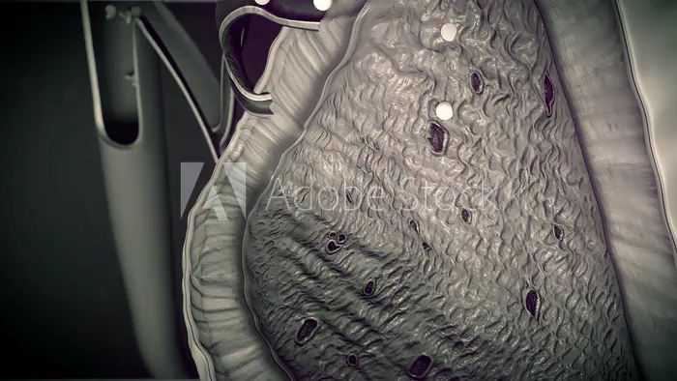
Adrenal Glands
The adrenal glands are a pair
of small, triangular-shaped
endocrine glands located on
top of each kidney and consist of
two parts: the adrenal cortex
and the adrenal medulla.
Adrenal Cortex: Adrenal cortex produces hormones such as cortisol, aldosterone, and sex hormones(androgens). These hormones regulate metabolism, blood pressure, and electrolyte balance.
Adrenal Medulla: The adrenal medulla releases hormones like adrenaline(epinephrine) and norepinephrine, which are involved in the body’s “fight or flight” response to stress.

Slide 10
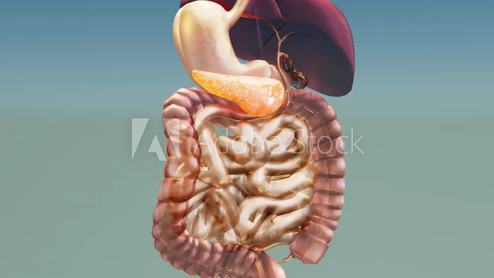
Pancreas
The pancreas is a multifunctional organ involved in both endocrine and exocrine activities. Its endocrine function regulates blood sugar levels through insulin and glucagon, while its exocrine function contributes to the digestive process through the release of pancreatic enzymes. Dysfunction of
the pancreas can lead to
significant health issues,
including diabetes and
digestive disorders.

Slide 11
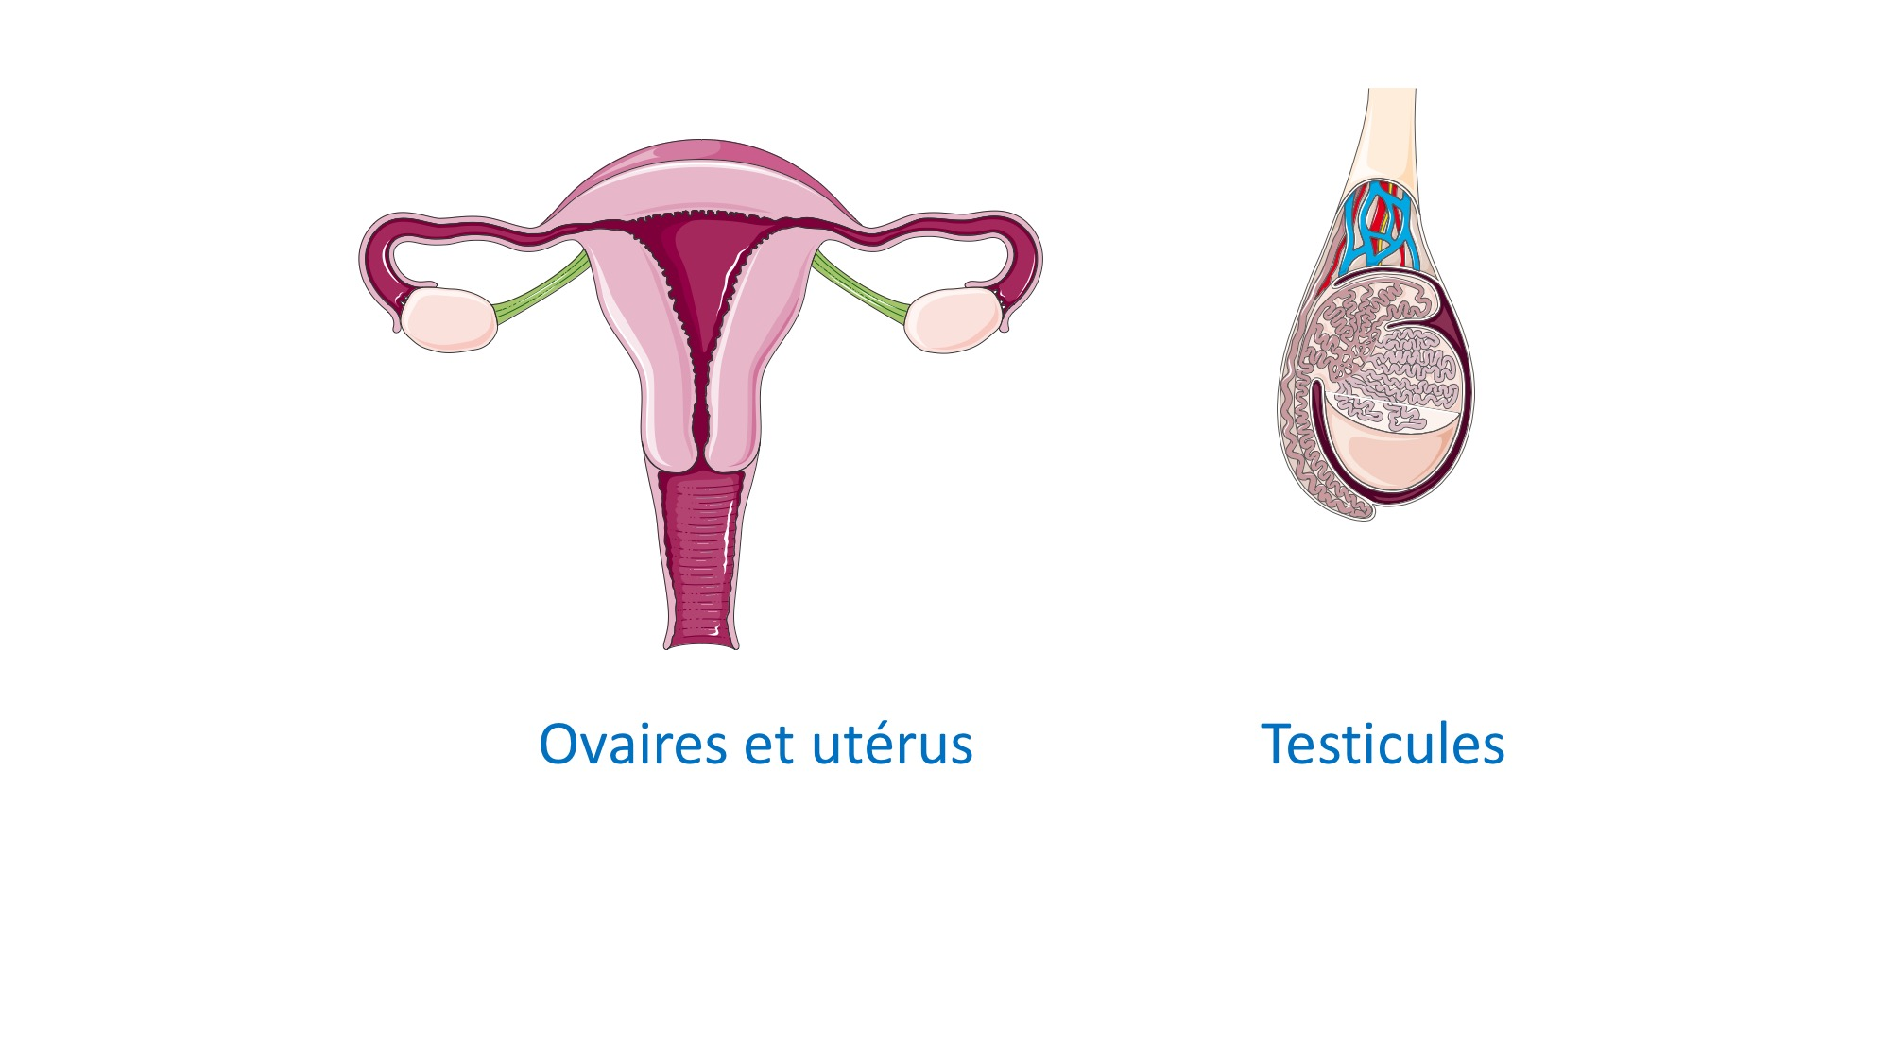
Gonads
"Gonads" is a term used to refer to the reproductive organs responsible for the production of gametes (sex cells) and the secretion of sex hormones. In humans, gonads are present in both males and females and play vital roles in the reproductive system.
Ovaries:
In females, the ovaries produce estrogen and progesterone, which regulate the female reproductive process and secondary sexual characteristics.
Testes:
In males, the testes produce testosterone, which controls male reproductive processes and secondary sexual characteristics.

Slide 12
Interactions with the Nervous System
The endocrine system works closely with the nervous system to regulate and coordinate bodily functions. While the nervous system uses electrical impulses and neurotransmitters for rapid, short-term communication, the endocrine system employs hormones for slower, long-term communication.
Functions of the Endocrine System
The endocrine system is involved in numerous physiological processes, including:
Regulation of metabolism (e.g., insulin and glucagon in the pancreas)
Control of growth and development (e.g., growth hormone from the pituitary gland)
Regulation of the sleep-wake cycle (e.g., melatonin from the pineal gland)
Maintenance of electrolyte balance (e.g., aldosterone from the adrenal glands)
Control of reproductive functions (e. g., estrogen and testosterone)

Slide 13
Disorders of Endocrine System
Diabetes Mellitus Type 1(E10)
Diabetes Mellitus Type 2(E11)
Hypothyroidism
Hyperthyroididm
Cushing’s Syndrome(E24.9)
Addison’s Disease
Polycystic Ovary Syndrome(PCOS)(E28.2)
Hyperparathyroidism
Hypogonadism

Slide 14
Diabetes Mellitus Type 1 (E10)
Type 1 diabetes mellitus (T1D) is an autoimmune disease that leads to the destruction of insulin-producing pancreatic beta cells
T1D require life-long insulin replacement with multiple daily insulin injections daily, insulin pump therapy, or the use of an automated insulin delivery system

Slide 15
Diabetes Mellitus Type 2
It is characterized by high levels of sugar in the blood
Type 2 diabetes is a long-term medical condition in which your body doesn't use insulin properly, resulting in unusual blood sugar levels
Type 2 diabetes mellitus (T2DM) accounts for around 90% of all cases of diabetes

Slide 16
Hypothyroidism
Hypothyroidism (underactive thyroid) is a condition where the thyroid gland doesn't release enough thyroid hormone into the bloodstream
Thyroid hormones control the way your body uses energy, so they affect nearly every organ in your body, even the way your heart beats
Without enough thyroid hormones, many of your body’s functions slow down

Slide 17
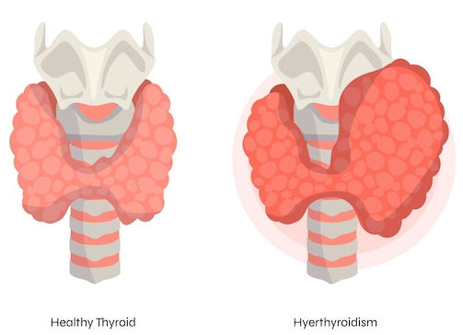
Hyperthyroidism
Hyperthyroidism happens when the thyroid gland makes too much thyroid hormone
This condition also is called overactive thyroid
Hyperthyroidism speeds up the body's metabolism. That can cause many symptoms, such as weight loss, hand tremors, and rapid or irregular heartbeat

Slide 18
Cushing Syndrome
Cushing disease (also called Cushing's disease or hypercortisolism) occurs when your body makes too much cortisol, a hormone related to the body's stress response
t's a rare pituitary disorder that is progressive. That means that without treatment, it gets worse over time

Slide 19
Addison’s Disease
Addison's disease, also called adrenal insufficiency, is an uncommon illness that occurs when the body doesn't make enough of certain hormones
In Addison's disease, the adrenal glands make too little cortisol and, often, too little of another hormone, aldosterone

Slide 20
Polycystic Ovary Syndrome(PCOS)
Polycystic ovary syndrome is a condition in which your hormones are out of balance(androgens)
The syndrome is named after cysts which form on the ovaries
PCOS can be associated with problems such as irregular menstrual cycles, excessive facial and body hair growth, acne, obesity, reduced fertility and increased risk of diabetes

Slide 21
Hyperparathyroidism
PCOS can be associated with problems such as irregular menstrual cycles, excessive facial and body hair growth, acne, obesity, reduced fertility and increased risk of diabetes
There are 4 small glands that make this hormone, which helps your body manage the calcium levels it needs

Slide 22
Hypogonadism
Hypogonadism occurs when the body's sex glands (gonads) produce little or no hormones
In men, these glands are the testes. Low testosterone (male hypogonadism) is a condition in which your testicles don't produce enough testosterone
Hypogonadism in females describes the inadequate function of the ovaries, with impaired production of germ cells (eggs) and sex hormones (estrogen and progesterone)

Slide 23
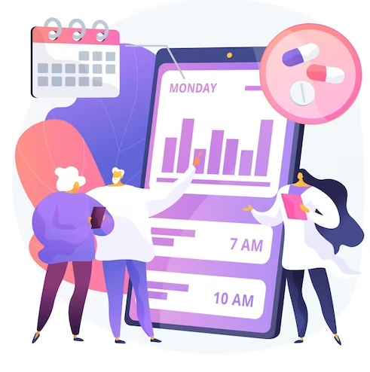
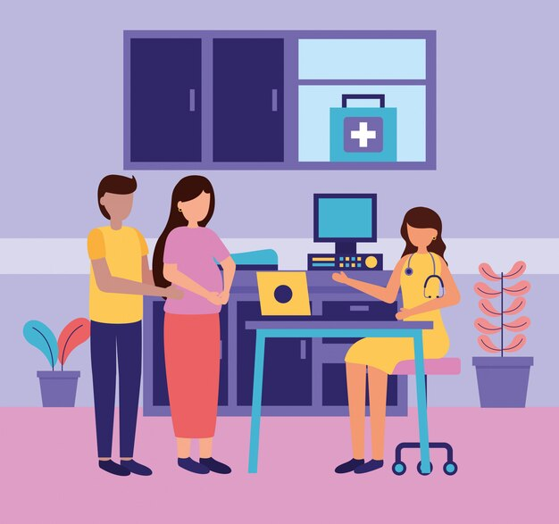
Patient Scheduling
What is Patient Scheduling
Reschedule
Cancel Appointment
No show
Check In
Check Out

Slide 24
Patient Demographics
Patient Status
Insurance Information
Patient Information
Mandatory Inforamtion
Optional Information

Slide 25
Eligibility Verification
Insurance Eligibility
Insurance Benefits
Co-Pay
Co-Insurance
Deductibles
Best Practices for Eligibility
Timely Verification
Accurate Data Entry
Communication with Insurance Provider
Thorough Documentation
Regular Training Updates for Staff

Slide 26
Patient Encounter
Types of Encounter
Face to Face Encounter
Telemedicine Encounter
Emergency Room Encounter
Outpatient Encounter
Inpatient Encounter
Specialist Encounter

Slide 27
Key Components In Patient Encounter
Chief Complaint(CC)
Diagnosis And Assessment
Treatment Plan
Communication and Education
Documentation
Follow-up Plan
Impact of Technology on Patient Encounter
EHR
Telemedicine Platforms
Mobile Health Applications
Efficiency and Quality Enhancement
Data Security and Privacy

Slide 28
Charge Entry
What Is Charge Entry
Medical Coding
ICD
CPT
Modifiers
Entering Data In Charge Sheet

Slide 29
Payment Posting
What is Payment Posting
Payments Methods
Payment By Check
Payment By EFT
Payment By Credit Card
Claim Payment Breakup
Allowed Amount (AA)
Paid Amount (PA)
Patient Responsibility(PR)
Write-off

Slide 30
AR-Follow up
Introduction
Importance Of AR-follow up
Key Objectives
Timely Collection
Aging Reduction
Bad Dept Minimization
AR Aging Categories
0-30 days
31-60 days
61-90 days
91+ days

Slide 31
AR Follow-up Workflow
Identifying unpaid Invoices
Sending Reminders and statements
Contacting Clients or Payers for Payments
Resolving Billing Disputes
Effective Communication in AR Follow-up

Slide 32
Patients Billing

Slide 33
Compliance Should be followed

